Slide 1
Environmental Measures in China
Do the measures really help?
Wang Anqi

Slide 2
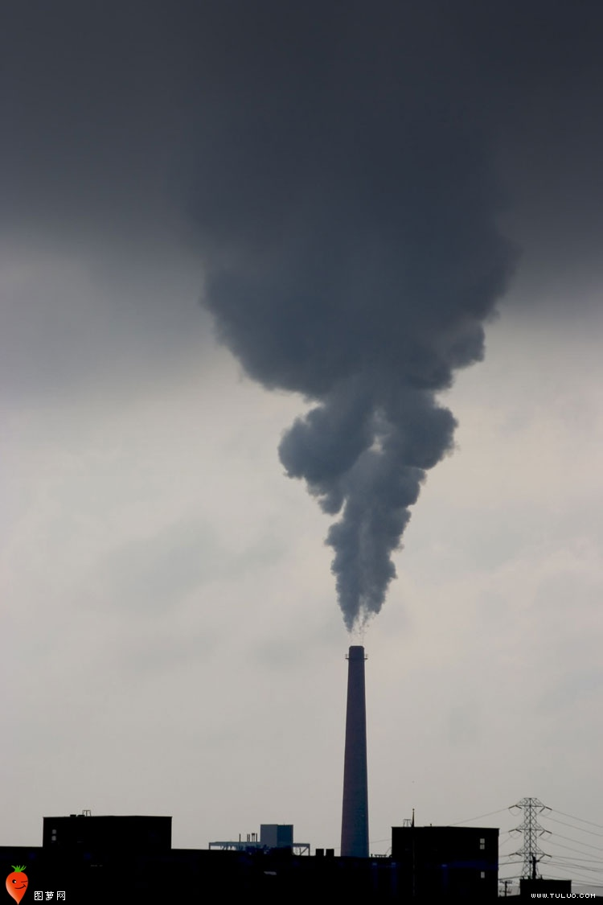
With the development of industry, the environmental protection problem appears especially urgent.

Slide 3
Artificial Rainfall
Launch AgI to the clouds

Slide 4
Water vapor condenses
Precipitation

Slide 5
“The chemicals used in the production of artificial rain could affect climatic patterns, ecosystem, water sources and the soil.”
“Excessive use of the chemicals will affect biodiversity and make the soil unproductive, besides being a water pollutant.”
Dr. Victoria Ngomuo

Slide 6
Source of Drinking Water

Slide 7
Car Restriction Policy

Slide 8
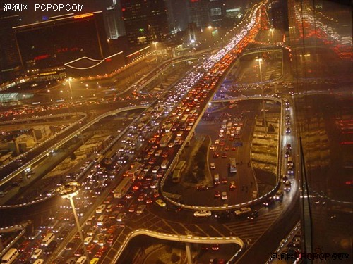

Slide 9
Car Restriction Policy

Slide 10
The capital's transport authorities stated “we received three times the monthly quota for new car license plate applications in the first two days of the year.”
China Daily January 3rd, 2011

Slide 11
The Arbor Day

Slide 12
“The survival rate of tree planting on every Arbor Day is lower than fifty percent. We spend from 30RMB to 80 RMB (5 dollars to 16 dollars) to purchase a young tree. The sum of purchasing trees is higher than the natural forests protection fee from government.” Liu Bing
21st Century Business Herald. March 10th 2012

Slide 13
Planted Forest

Slide 14
Wild-forests keep a good biodiversity.
Planted-forests have less species.

Slide 15
Environmental Ethics
“Anthropocentrism (human-centeredness) leads to environmentally damaging behaviors. Anthropocentrism is at the heart of the problem of environmental destructiveness. If anthropocentrism is the problem, then perhaps non-anthropocentrism is the solution. ”
Brennan Andrew and Lo Yeuk-Sze
Environmental Ethics.

Slide 16
Thank You

