Slide 1
Visual Analysis of an Advertisement
Anqi Wang

Slide 2
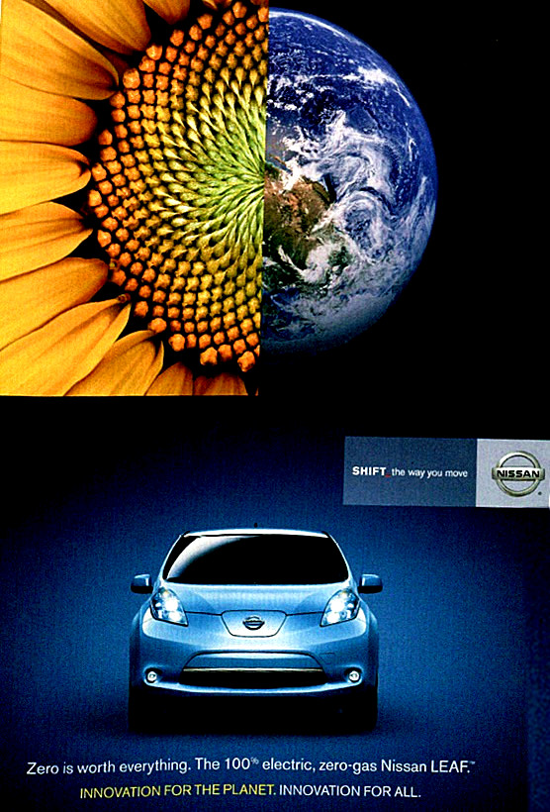
Popular Science Magazine, June 2011
Zero is worth everything.
The 100% electric, zero-gas Nissan LEAF.
INNOVATION FOR THE PLANET. INNOVATION FOR ALL.

Slide 3
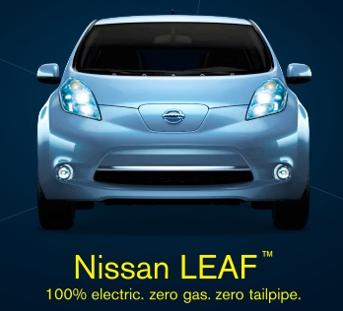
Thank You

